Slide 1
How to – Best Practices: Event Readiness
Tuesday, March 1
11:30am – 12:30pm

Slide 2
MODERATORS
Caroline Fenton, Paciolan
Derek Houtz, Paciolan
PRESENTERS
Sara Callaway, The Monument
Cody Chaney, Auburn University
Kyle Koch, University of Delaware
Bryan Shearon, Xtream Arena

Slide 3
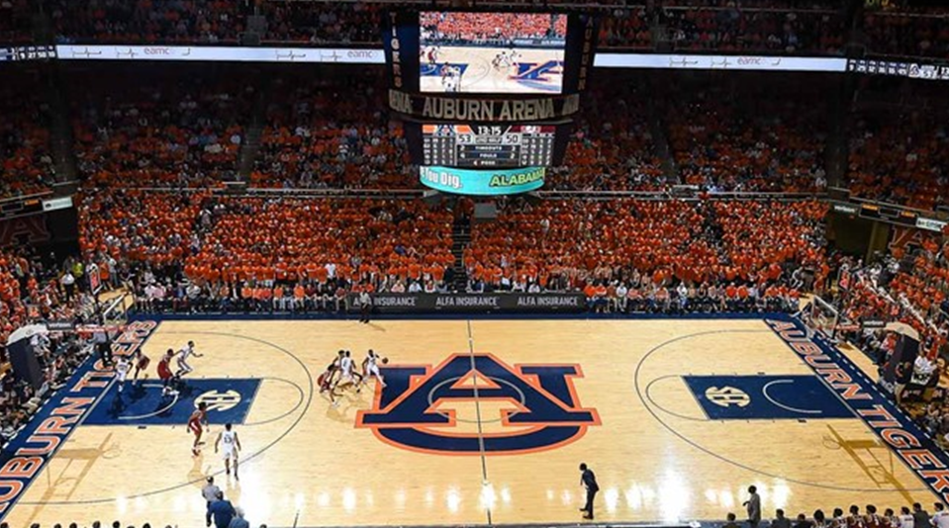
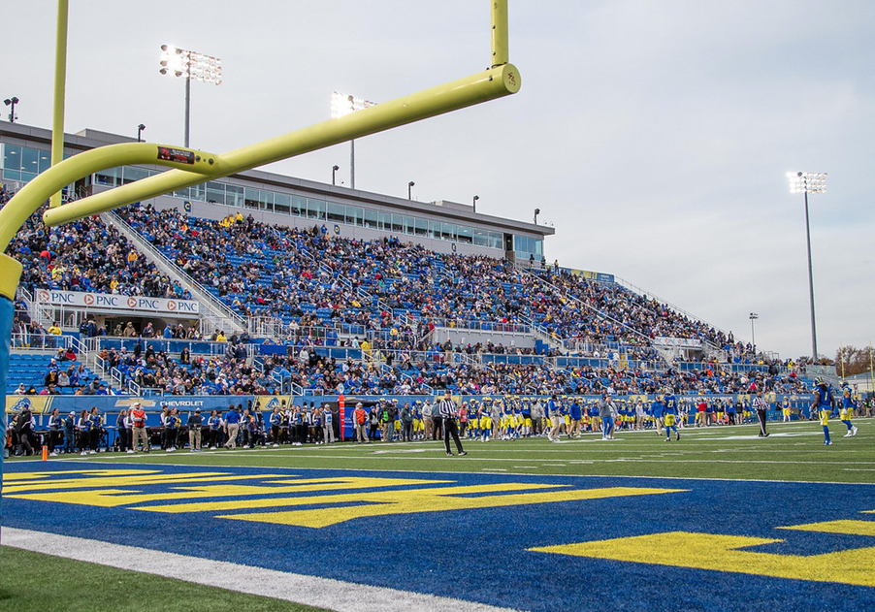
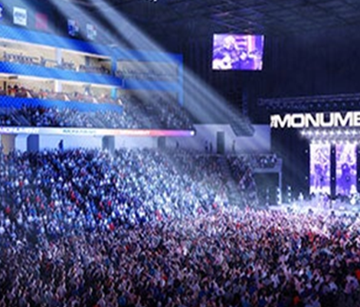
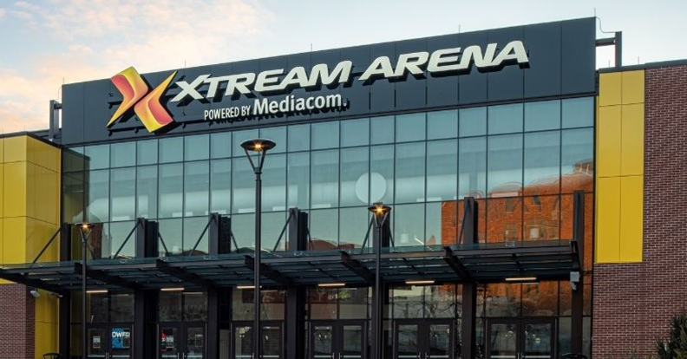

Slide 4

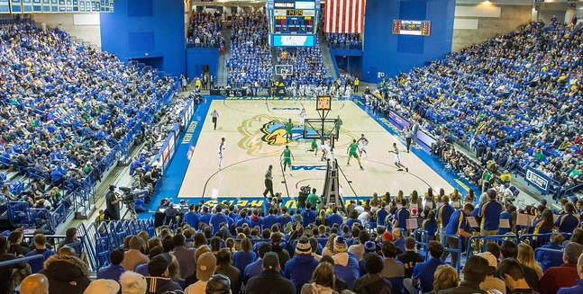


Slide 5
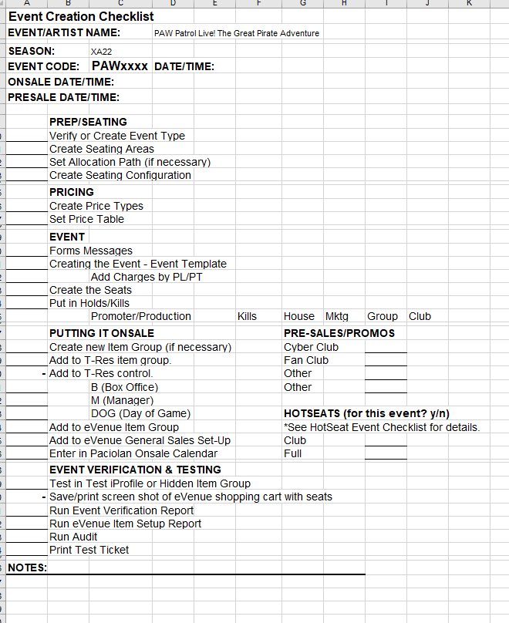


Slide 6
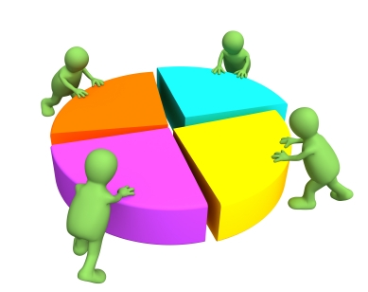

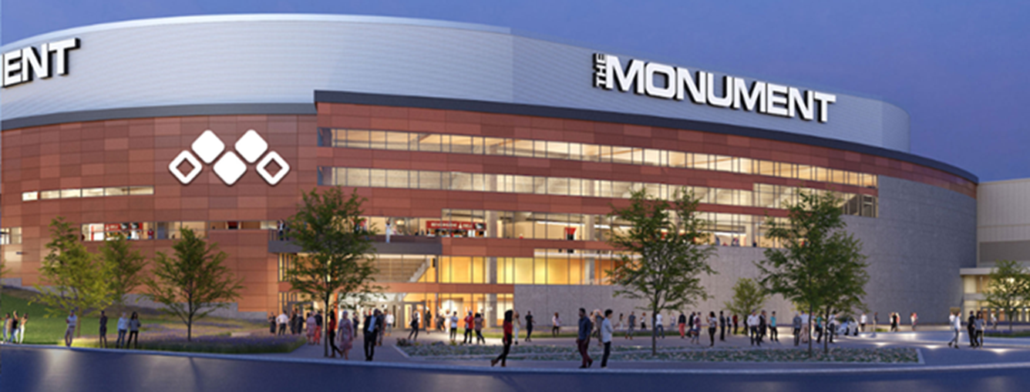
CONSOLIDATE
CHANGE IS NOW NORMAL

Slide 7
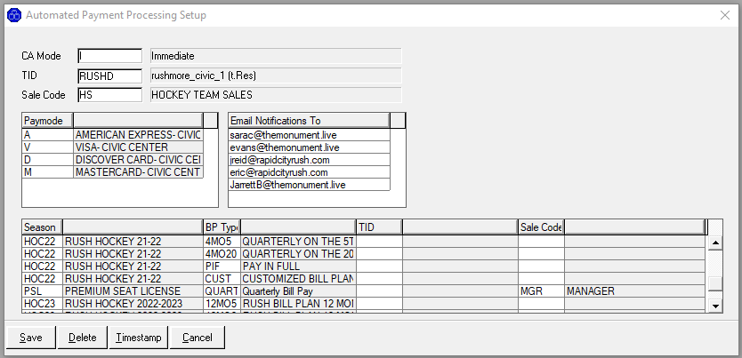
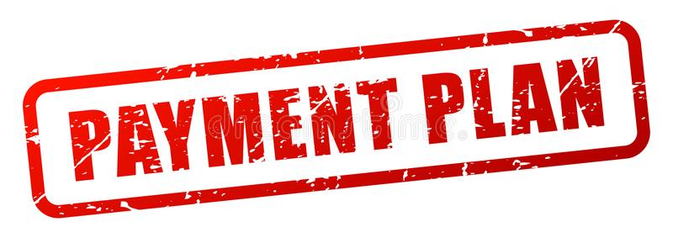
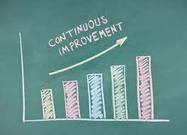
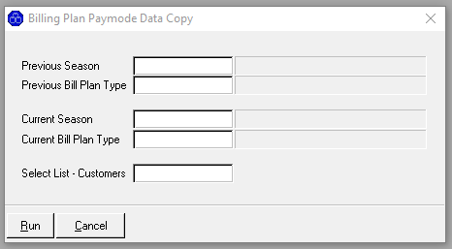

Slide 8
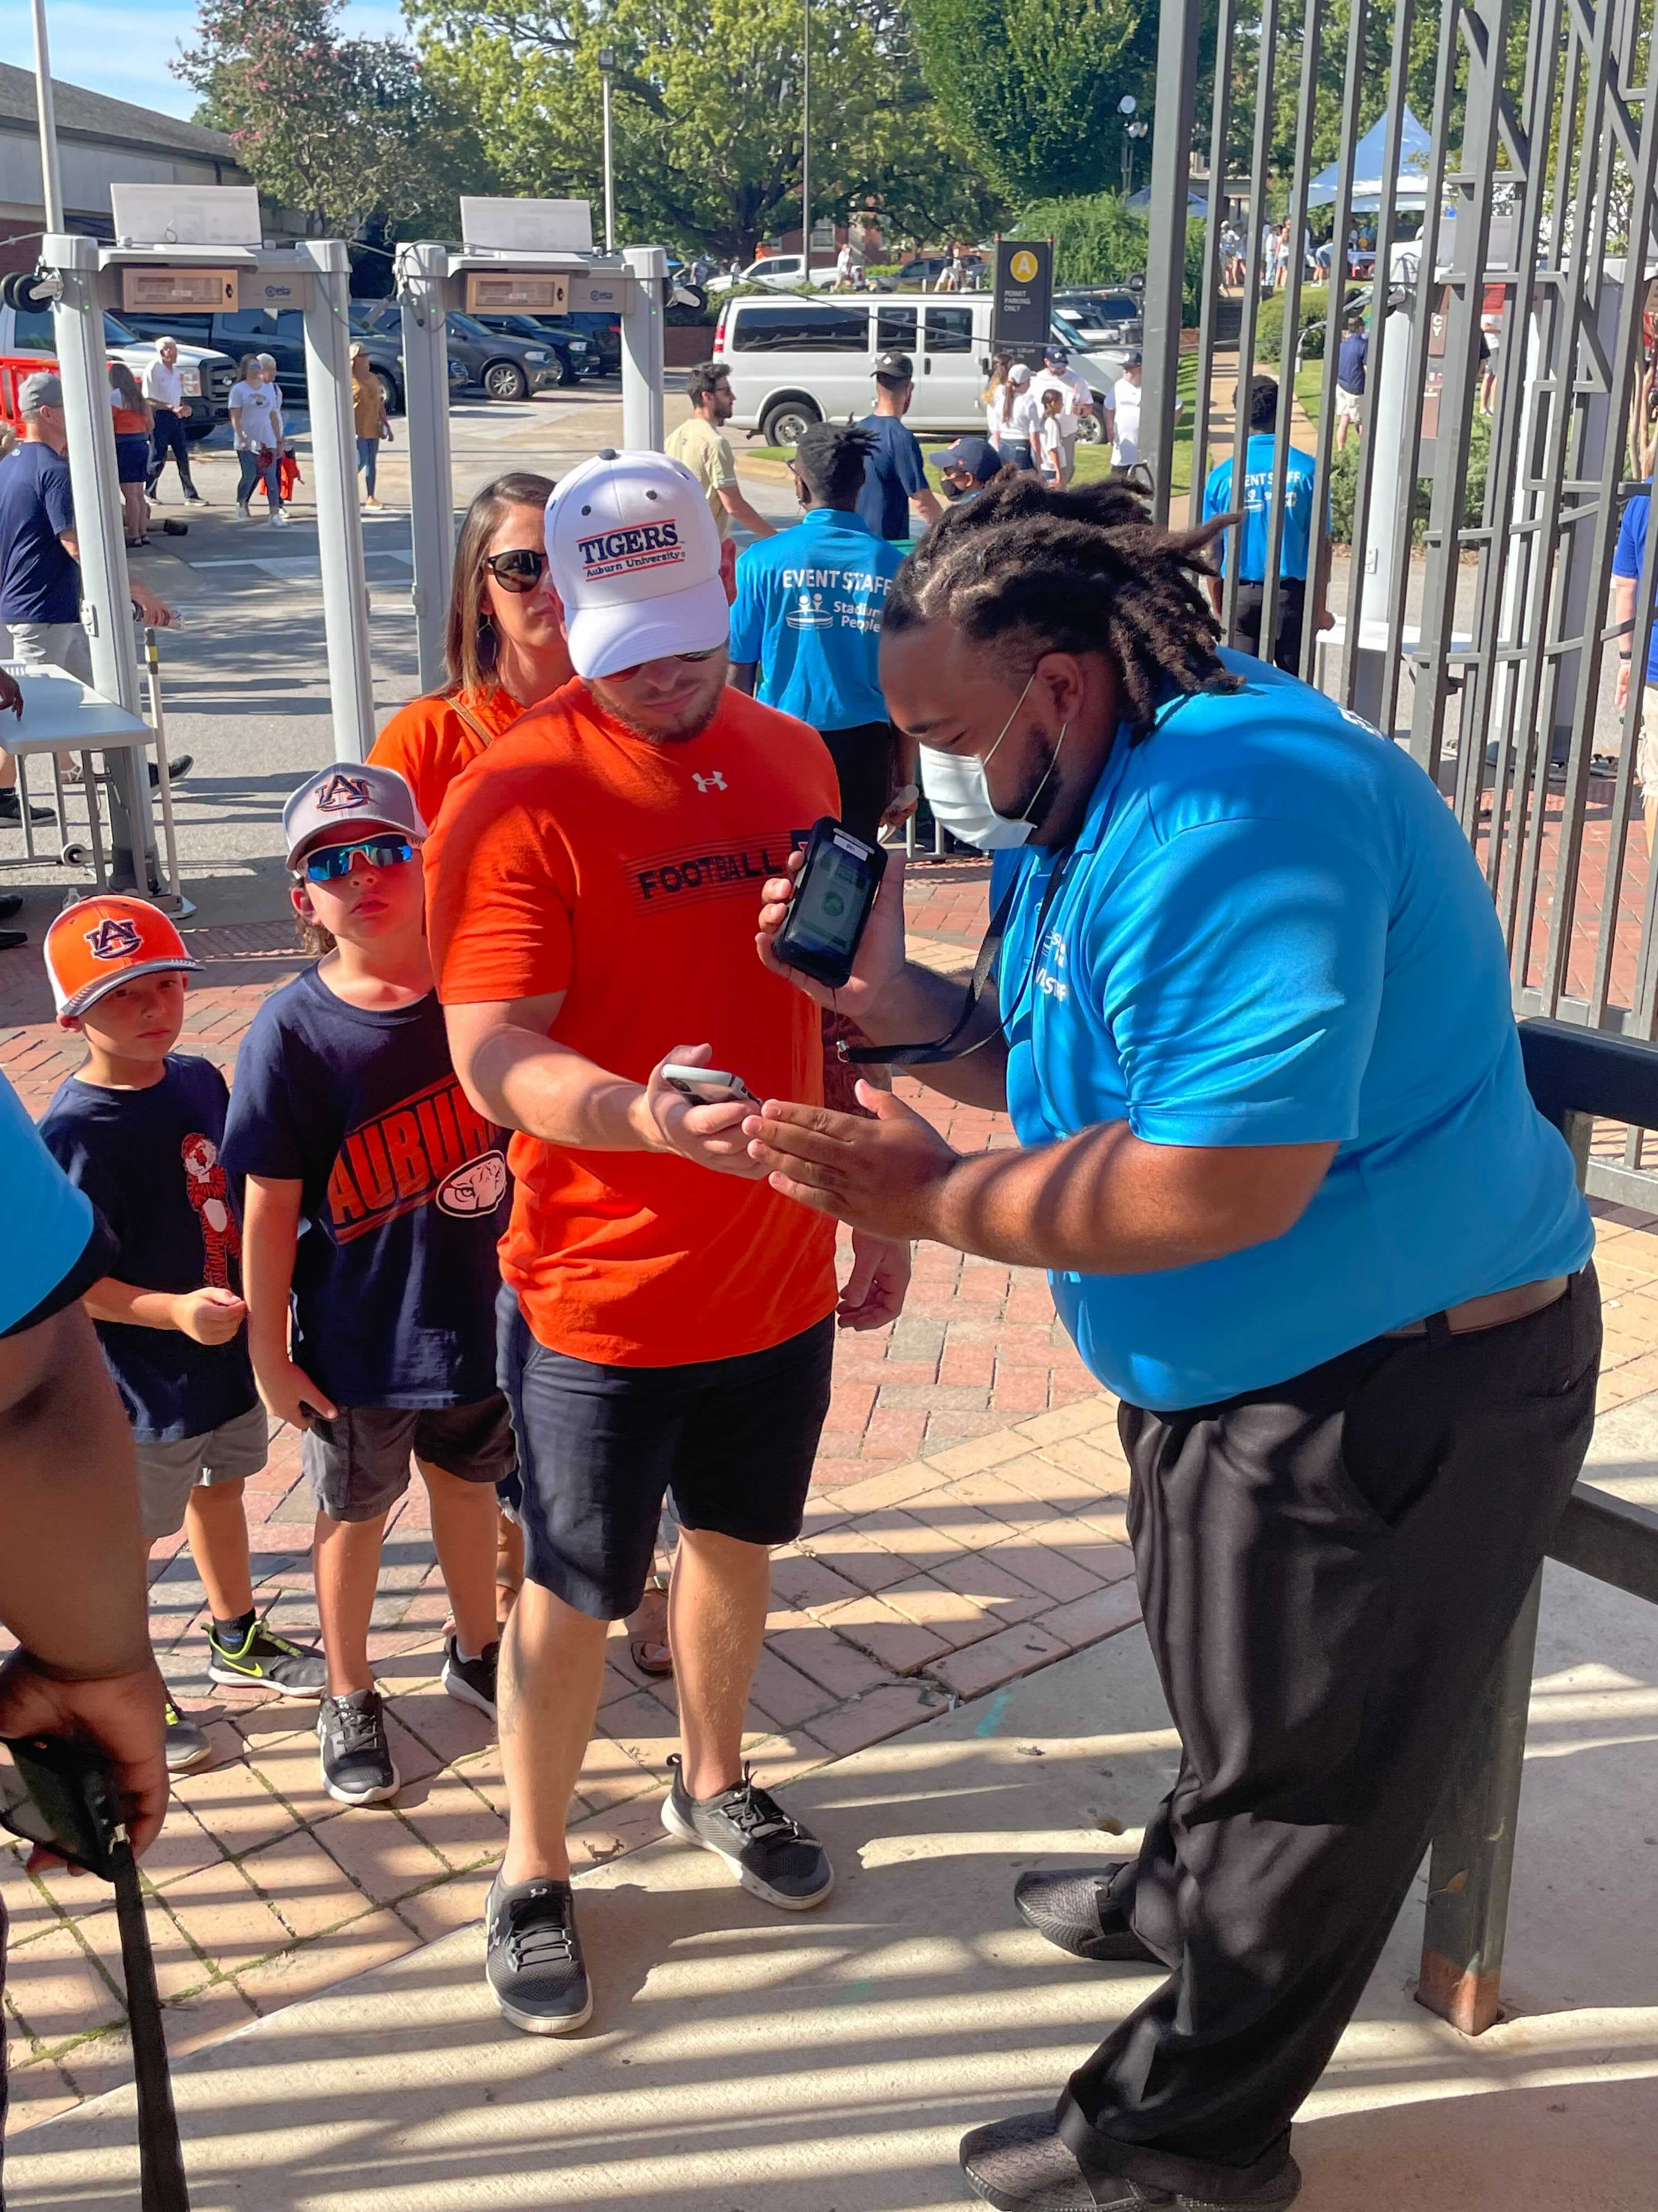
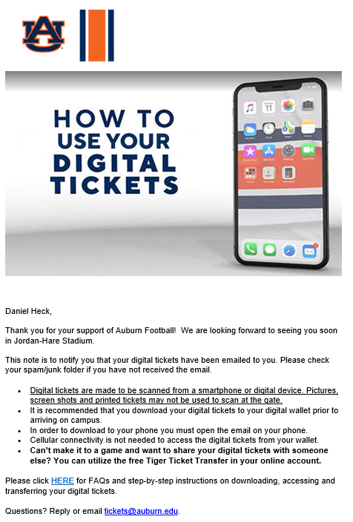
Educating the customer base and constant communication on digital initiatives…
~ Cody Chaney, Auburn University

Slide 9
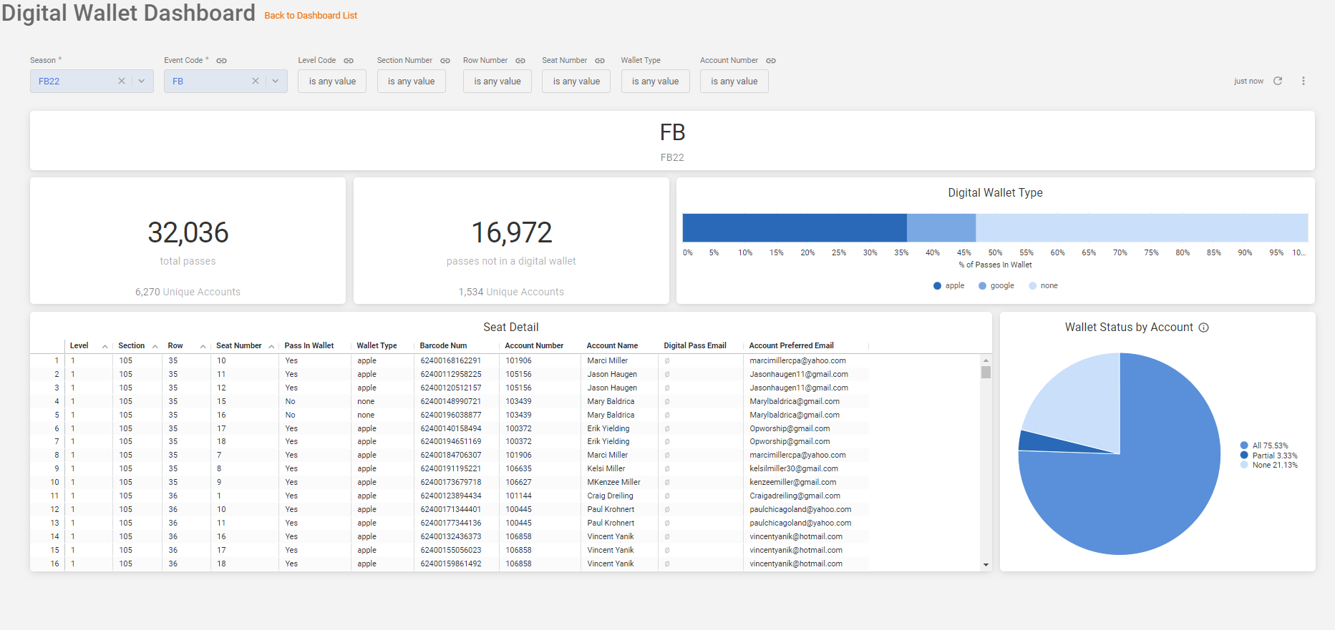


Slide 10
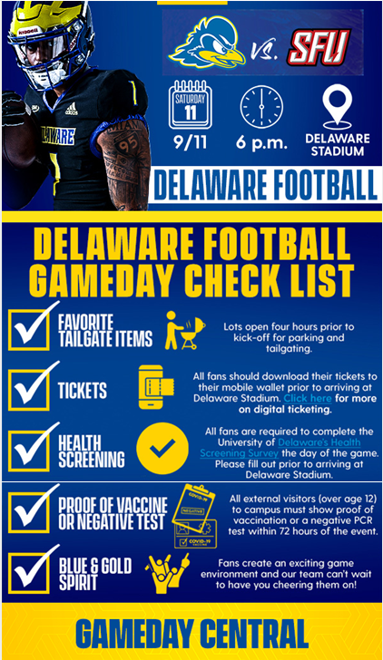
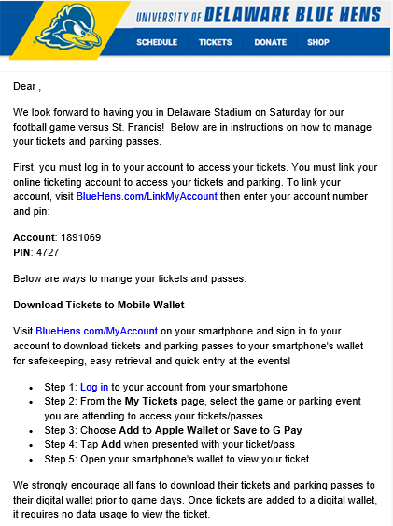

Slide 11
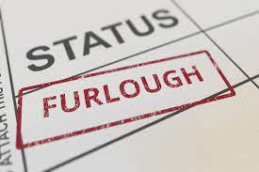

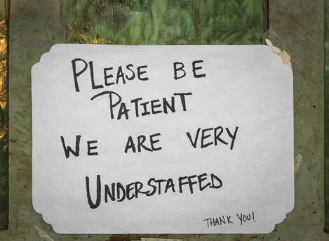
CREATIVE INCENTIVES
PANDEMIC REALITY

Slide 12

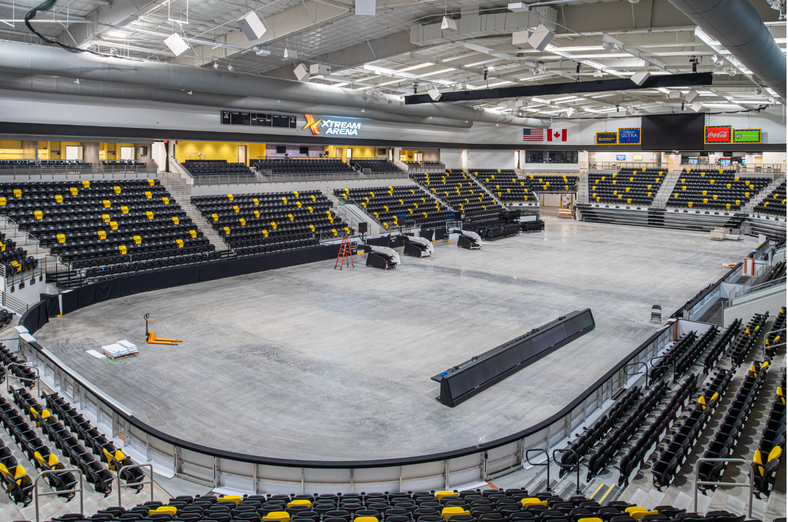

PACIOLAN WAS ONE CONSTANT

Slide 13
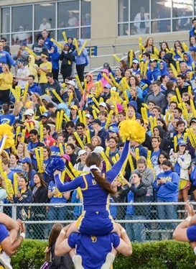
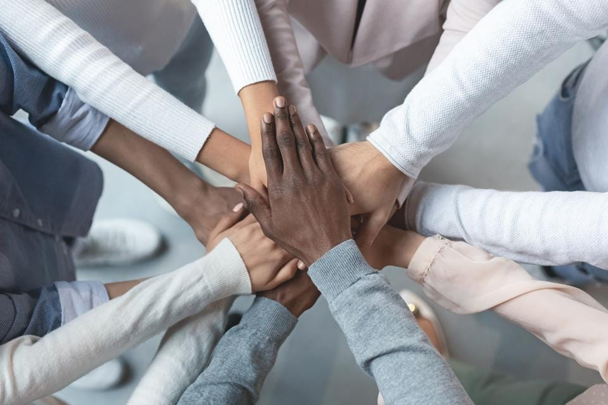



Slide 14


Slide 15
Parting words of wisdom …
Don’t be afraid to pick up the phone and call colleagues around the country….we are all in this together. ~ Kyle
Include and empower your young staff, never micromanage them….they are the future. ~ Cody
Change is now the norm and inevitable so roll with the punches and use the resources on the PAC community through LCS’s, documentation, and Customer Support.
~ Sara
Take the time when you have it, will save you time when you don’t. ~ Bryan

Slide 16
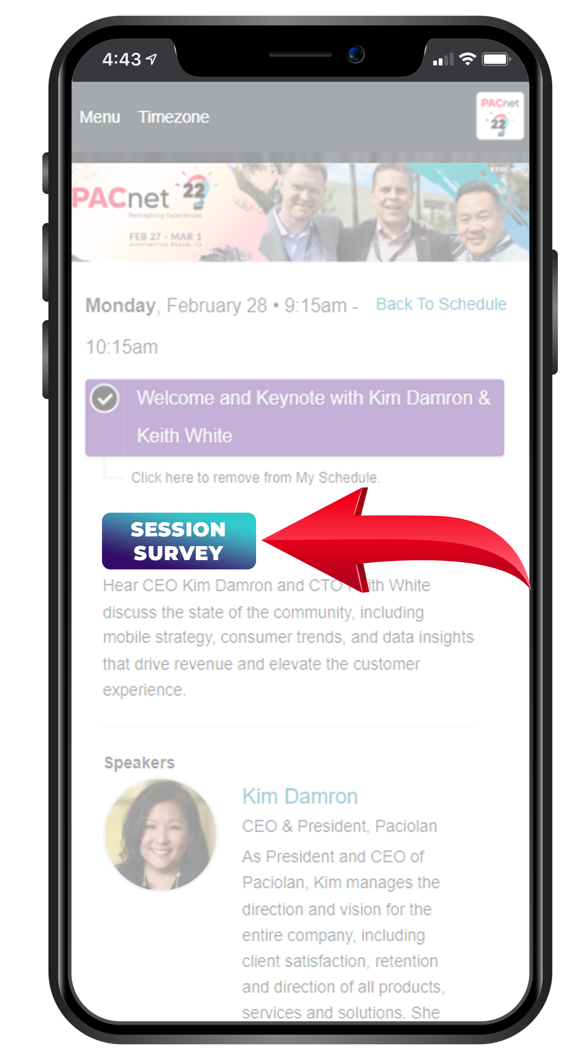
THANK YOU!
QUESTIONS?
Please complete the online session evaluation.

Slide 17
Valuable Links
LCS – “The Comeback”
LCS – Event Prep
Onsale Checklist
Event Build Checklist
LCS – New Bulk Ticketing Processes
  Item Cancel
  Order Charge Cancel
  Bulk Unprint
Customer Progress Reports
LCS – Reintroduction to PYO Maps
LCS – Automated Payment Processing for Ticketing
  TK.AUTO.PAY.SETUP
LCS – Billing Plan Paymode Copy
  TK.BPLAN.PMODE.MOVE
PAC Data & Insights: Digital Wallet
Ticket Training Guide
Operational Readiness
LCS - Event Build – Deep Dive
LCS - Renew, Reorder, Reallocation
Seat Status Import

